Slide 1
Introduction to Machine Learning
Tyler Zhu
Princeton AI4ALL 2024
Slides adapted from Wells Lucas Santo and Nobline Yoo and Indu Panigrahi(AI4ALL)

Slide 2
Icebreaker

Slide 3
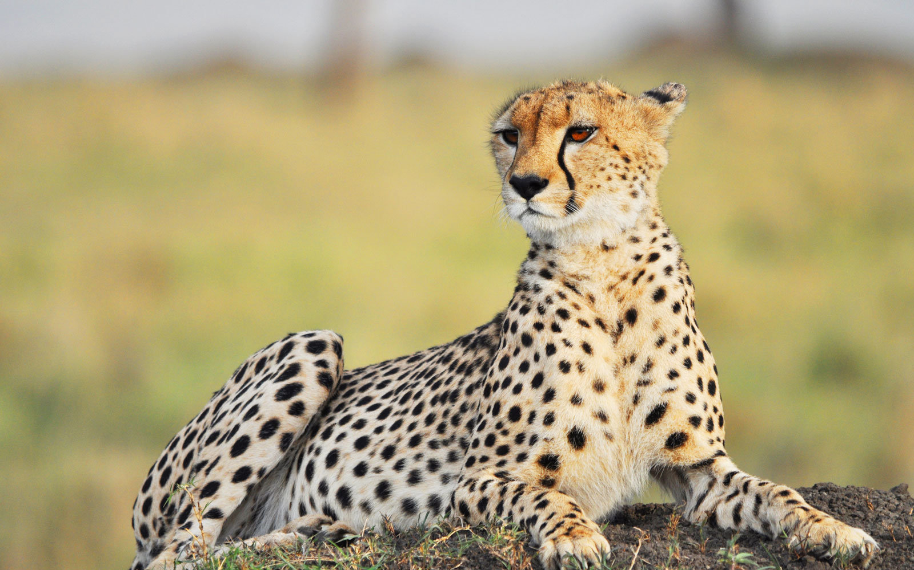
Learning from Examples
Notes:
Think about how a human learns to identify a cheetah -- if someone verbally describes a cheetah, we might have an idea of what it looks like, but really the best way to understand what a cheetah looks like is by seeing examples of one. Humans learn from examples -- could we teach computers by doing something similar?
Note descriptors -- like four legs, two ears, spots -- but this could describe many animals

Slide 4
Machine Learning
Machine Learning (ML) is an approach to teach computers how to make decisions and predictions, by giving them the ability to learn from data.

Slide 5
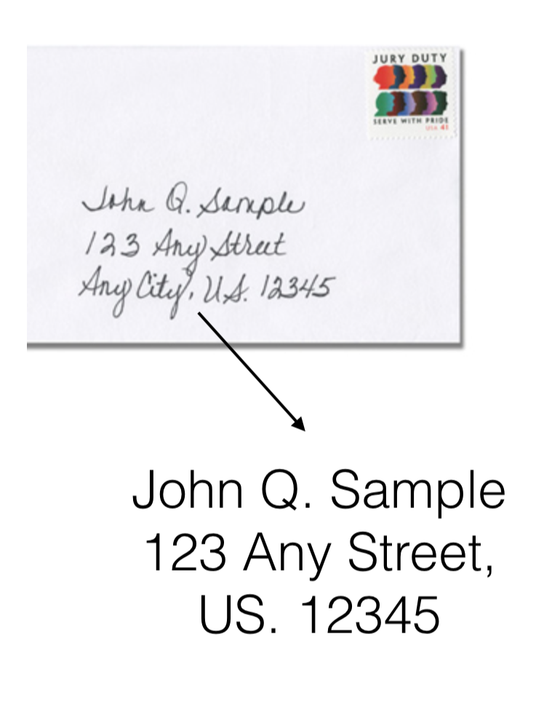
Why use Machine Learning?
Some tasks are too complex for us to fully describe on our own
Imagine a program to look at handwritten text and figure out what it says
There are too many different handwriting styles for us to describe all variations
ML gives us a way to tell the computer how to learn without needing to describe what to learn
Notes:
ML gives us a way to tell the computer how to learn without needing to describe what to learn

Slide 6
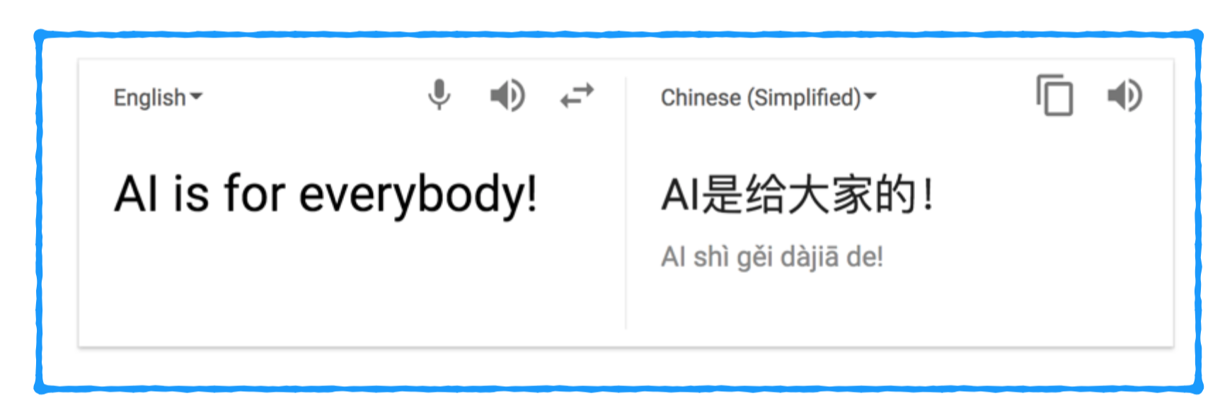
Machine Translation
Benefits of using ML for translation:
Can translate a language that you have no idea how to speak
Can reduce the time spent programming
Can easily reuse the same approaches to learn new languages
Notes:
A specific example of the benefits of using machine learning -- for translation

Slide 7
How is ML different from AI?
Machine learning is a type of artificial intelligence
Artificial Intelligence
Machine Learning
Notes:
You learned the keyword AI in Day 1

Slide 8
How is ML different from AI?
Machine learning is a type of artificial intelligence
Machine learning makes decisions based on data it has seen
Artificial Intelligence
Machine Learning

Slide 9
How is ML different from AI?
Machine learning is a type of artificial intelligence
Machine learning makes decisions based on data it has seen
Not all AI algorithms need to do this (e.g. A* search)
Artificial Intelligence
Machine Learning
Notes:
Note that the recall A* should be taken out for slides where graph searches were not taught prior
If A* was taught, this is a good opportunity to ask them to recap what it is
If A* was not taught, this is a good opportunity to mention it (or other non-ML AI) in passing as examples, to make it concrete that there can exist AI that isn’t ML

Slide 10
How is ML different from AI?
Machine learning is a type of artificial intelligence
Machine learning makes decisions based on data it has seen
Not all AI algorithms need to do this
Artificial Intelligence
Many of the latest AI systems all make use of ML
Machine Learning
Notes:
Note that the recall A* should be taken out for slides where graph searches were not taught prior

Slide 11
How is ML different from AI?
Machine learning is a type of artificial intelligence
Machine learning makes decisions based on data it has seen
Not all AI algorithms need to do this
Artificial Intelligence
Many of the latest AI systems all make use of ML
For this reason, many people use the terms AI and ML interchangeably
Machine Learning

Slide 12
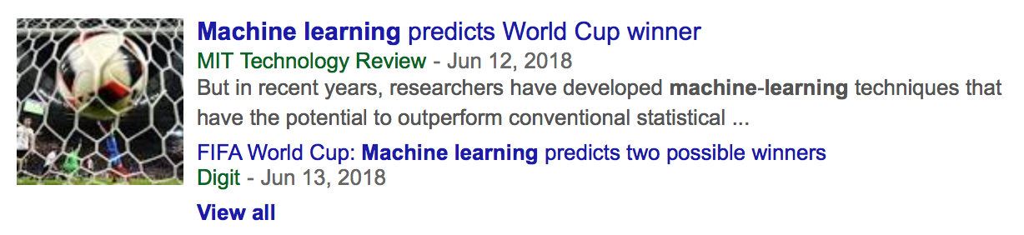
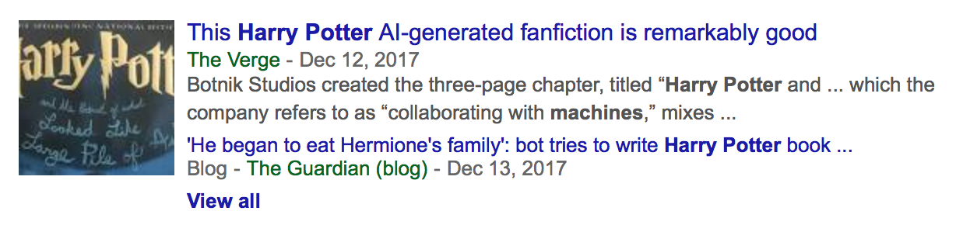
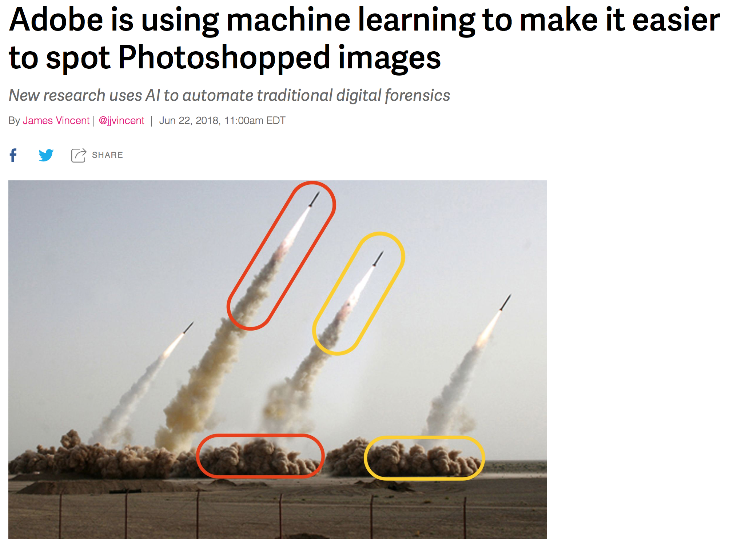
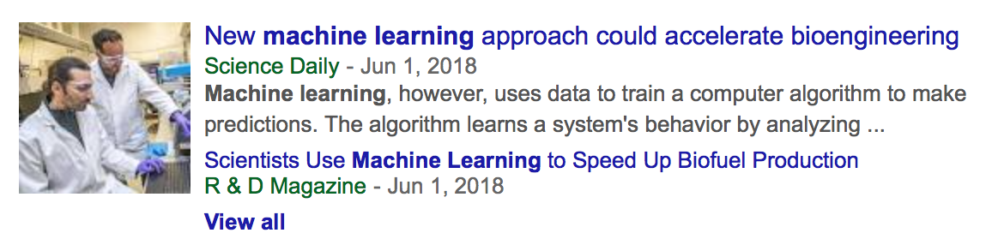
Machine Learning in the News

Slide 13
Types of Machine Learning
Notes:
~20 minutes

Slide 14
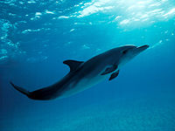
Supervised Learning
Notes:
Say we have an image of an animal and want to identify what type of animal is in that image

Slide 15
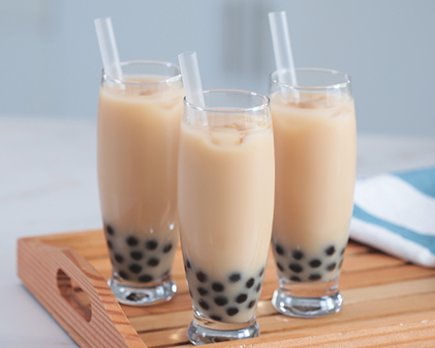
Supervised Learning
Notes:
Or say we have past amount of sales of milk tea and want to predict how much milk tea we’ll sell in the future
Both of these very different examples are examples of supervised learning… but what makes them related?

Slide 16
Supervised Learning
Supervised Learning: a type of machine learning where we are given labelled data as an input and attempt to output the correct label

Slide 17

Supervised Learning
Supervised Learning: a type of machine learning where we are given data as an input and attempt to output the correct label
For example, we can take an email as input and assign it the label spam or not spam

Slide 18
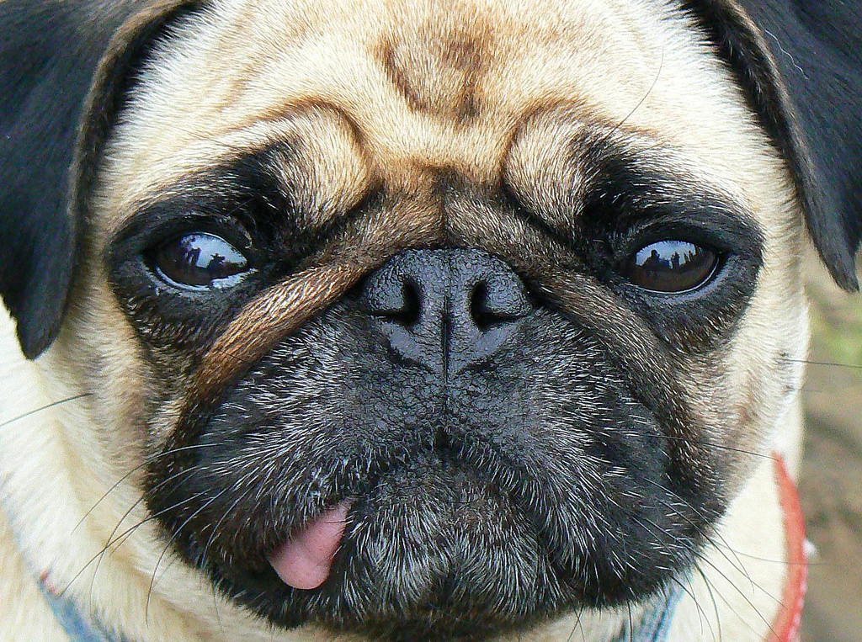
Supervised Learning
Supervised Learning: a type of machine learning where we are given data as an input and attempt to output the correct label
For example, we can take an email as input and assign it the label spam or not spam
Or, we can take an image as input and assign it with the label cheetah, dog, wolf, etc.

Slide 19
Supervised Learning
Supervised Learning: a type of machine learning where we are given data as an input and attempt to output the correct label
For example, we can take an email as input and assign it the label spam or not spam
Or, we can take an image as input and assign it with the label cheetah, dog, wolf, etc.
A specific instance of our data (one particular email or image) is called an example
Notes:
Be sure to pause here and check for questions

Slide 20
Building Models
We want to build a model of the world, one that understands how to correctly assign a label to an example

Slide 21
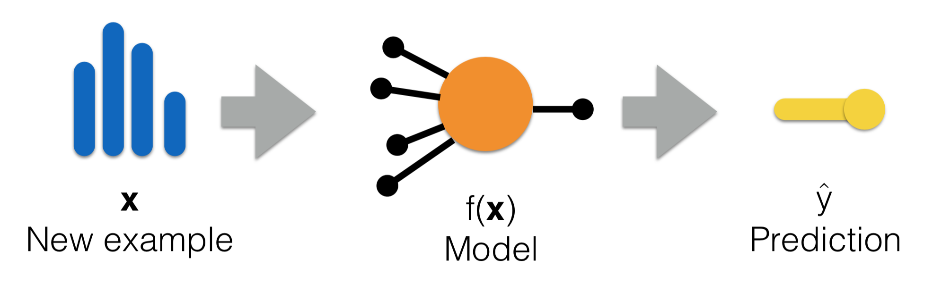
Building Models
We want to build a model of the world, one that understands how to correctly assign a label to an example
You can think of a machine learning model as a mathematical function that maps examples to predicted labels
Notes:
You might need to appeal to other familiar ideas to explain what a “model” is -- you can appeal to the idea of how we might make a toy model of a car or a model of a volcano -- it’s not the real car or volcano, but just what we estimate it to be -- this is what we’re doing with machine learning models, estimating reality
Also mention the notation -- a single example could be represented with the variable x, and you can think of a model like a function f(x), which outputs the prediction, y-hat . . . very concretely, x could be a picture, f(x) would be the model that we’ve built (aka our machine learning system), and y could be the prediction that is picture is of a dog

Slide 22
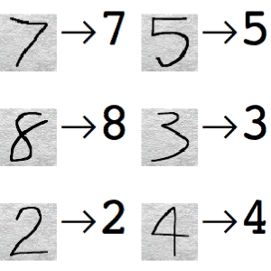
Supervised Learning
We learn from examples that are already labelled
Supervised because someone assigns what the correct labels are
?
Notes:
For instance, say we want to figure out from an image of a handwritten number what digit it is
We look at many labelled examples and then try to predict the label of a new, unseen example
Called supervised because we have an expert tell us what the “correct” labels for each example are.

Slide 23
Supervised Learning
Two types of tasks:

Slide 24
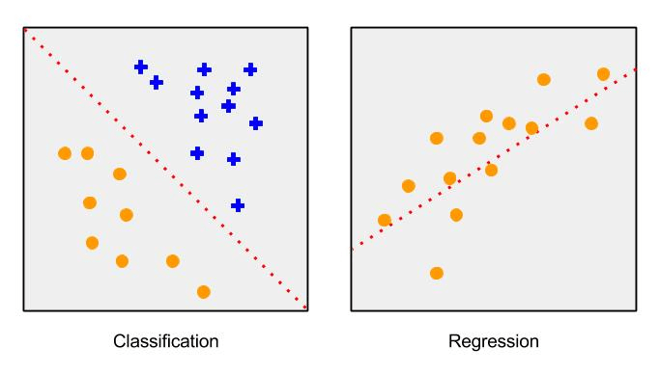
Supervised Learning
Two types of tasks:
Classification: When the label is a specific class
Determining if mail is spam or not spam
Determining if a picture has a cat or not
Notes:
Explain the graph, saying we want to draw a line where on one side everything is a circle, and on the other everything is a plus; that’s the goal of classification

Slide 25
Supervised Learning
Two types of tasks:
Classification: When the label is a specific class
Determining if mail is spam or not spam
Determining if a picture has a cat or not
Regression: When the label is a real number
Predicting tomorrow’s temperature
Predicting the cost of coffee in 2020
Notes:
Explain the graph, saying how we want to draw a line that best goes through all of the data points
If the graphs don’t make as much sense now, that’s ok! We’ll revisit them down the line

Slide 26
Supervised Learning
Two types of tasks:
Classification: When the label is a specific class
Determining if mail is spam or not spam
Determining if a picture has a cat or not
Regression: When the label is a real number
Predicting tomorrow’s temperature
Predicting the cost of coffee in 2020
Classification labels are discrete
Small number of possible values
Regression labels are continuous
Notes:
Students will be unfamiliar with the term ‘discrete’ -- explain that discrete is the opposite of continuous, meaning there are only a small number of possible values
For example, in the case of mail is spam or not spam, there are only two possible values… (1) spam or (2) not spam

Slide 27
Supervised Learning
Notes:
Or say we have past amount of sales of milk tea and want to predict how much milk tea we’ll sell in the future
Both of these very different examples are examples of supervised learning… but what makes them related?

Slide 28
Unsupervised Learning
Notes:
The next type of machine learning we will learn about is unsupervised learning

Slide 29
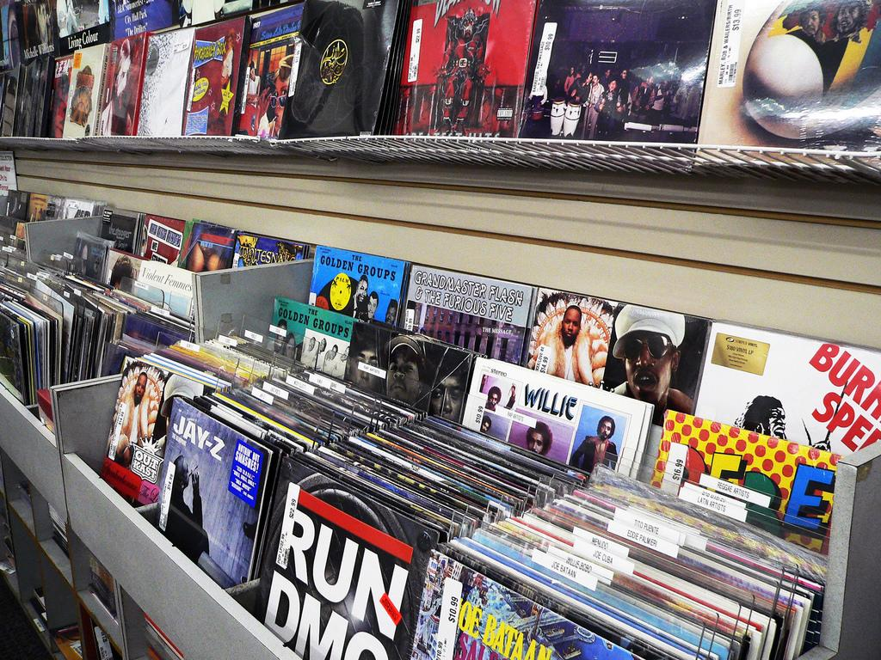
Unsupervised Learning
Notes:
Say we have a collection of music and we want to group them into categories based on shared properties

Slide 30
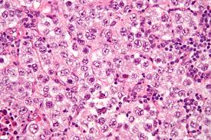
Unsupervised Learning
Notes:
Or say we have images of skin cells and want to find cells that look similar to each other
Unsupervised learning helps us with finding patterns and similarities within our data in order to discover new groupings for them

Slide 31
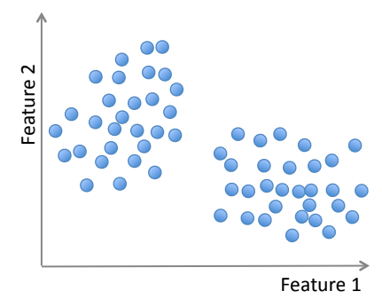
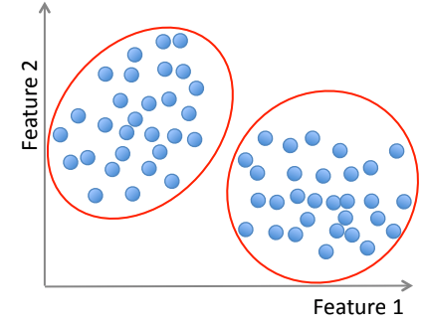
Unsupervised Learning
Unsupervised Learning: a type of machine learning where we attempt to make inferences about unlabelled data
Notes:
Could give specific example to make this more concrete, and relate it to the graphs on the right
Note that “features” aren’t defined yet as a ML term, but you can appeal to the common usage of the word -- let them know they can think of a feature like a property of the data
For instance, let’s say we have a collection of songs and say feature 1 is tempo (speed of the song) and feature 2 is number of instruments used in the song… we could then use an unsupervised learning algorithm to group the songs into two categories based on these two features

Slide 32
Unsupervised Learning
Unsupervised Learning: a type of machine learning where we attempt to make inferences about unlabelled data
These inferences could be:
Different ways to group that data
Anomalies that exist in the data
Finding new patterns in the data
Notes:
Could give specific example to make this more concrete, and relate it to the graphs on the right
Note that “features” aren’t defined yet as a ML term, but you can appeal to the common usage of the word -- let them know they can think of a feature like a property of the data
For instance, let’s say we have a collection of songs and say feature 1 is tempo (speed of the song) and feature 2 is number of instruments used in the song… we could then use an unsupervised learning algorithm to group the songs into two categories based on these two features

Slide 33
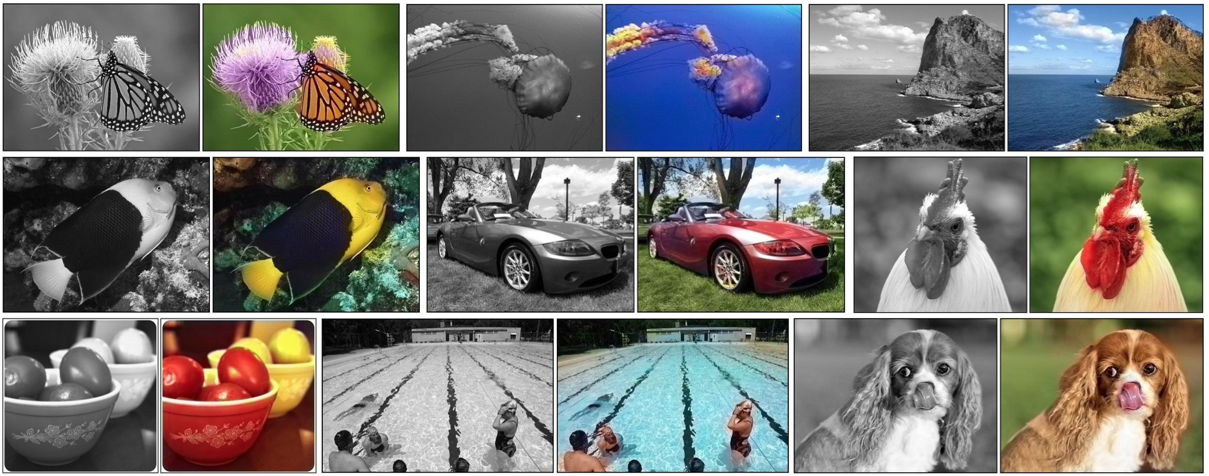
Unsupervised Learning

Slide 34

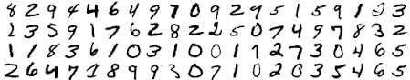
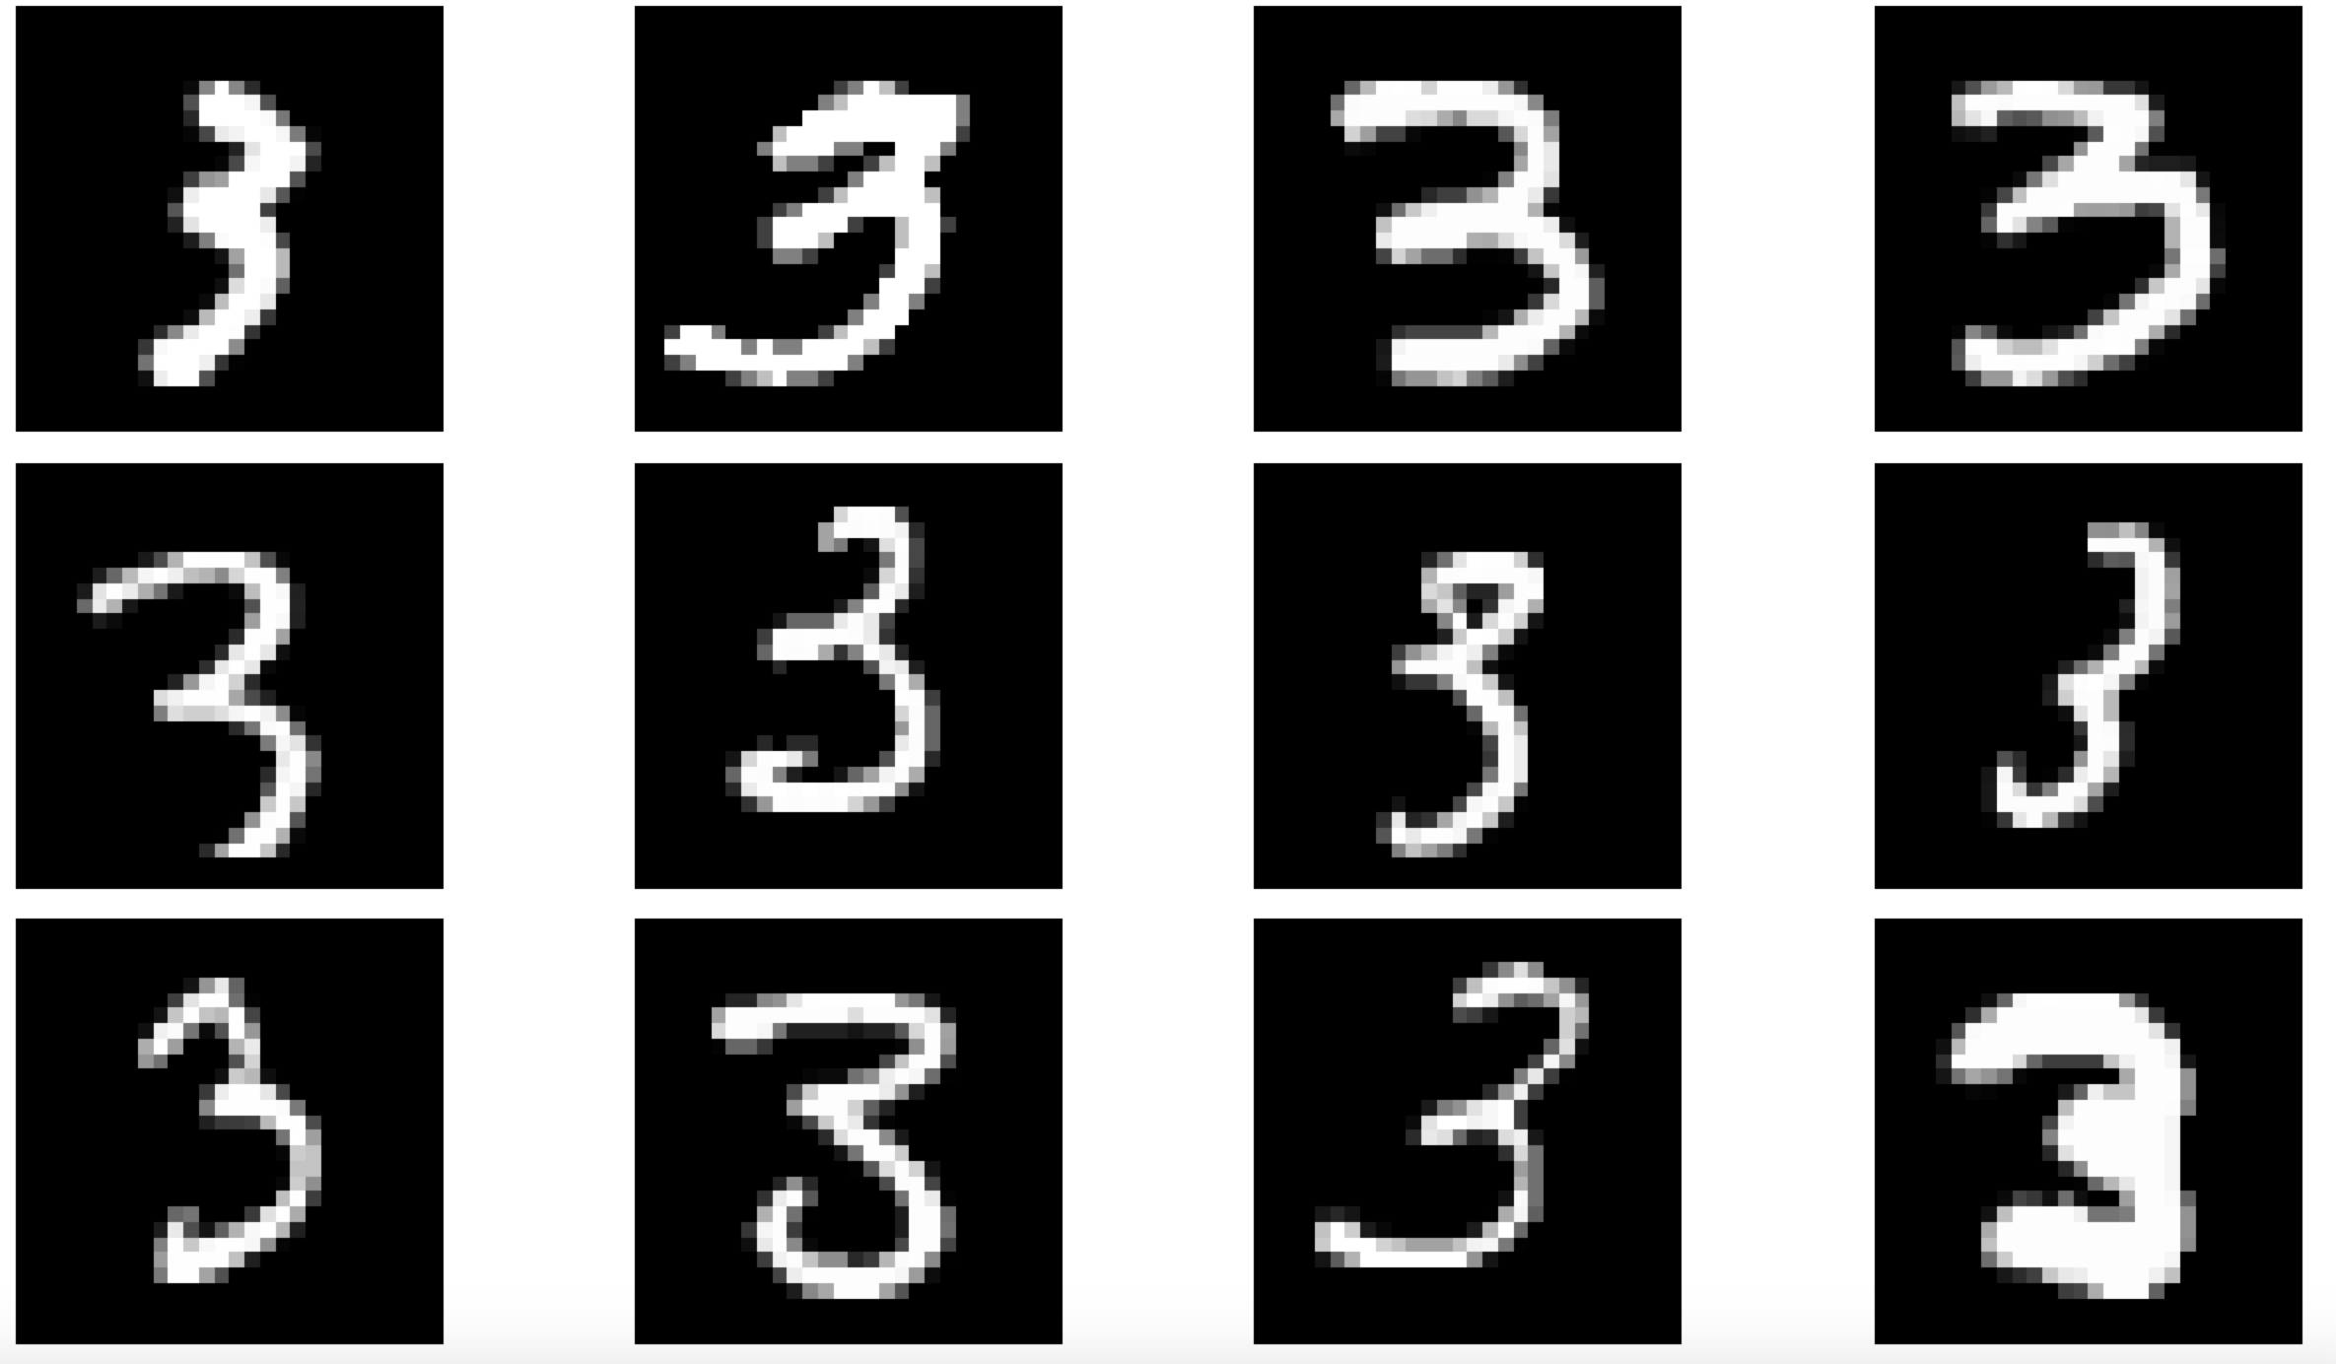
Supervised vs Unsupervised
?
Supervised Learning
Unsupervised Learning
Notes:
Can ask students what the main differences between supervised & unsupervised they think there are.
Main difference: labelled vs unlabelled data
When we have labelled data (supervised learning): there is an expectation of what the “right” answer is
When we do not have labelled data (unsupervised learning): we want to discover potentially new patterns in the data

Slide 35
Reinforcement Learning
A different way to approach machine learning, based on human psychology
Based on how humans learn about good decisions from rewards and bad decisions from penalties
Notes:
For example, you might touch a hot stove and it’ll burn (which is a negative reward, or penalty), and you’ll learn not to touch it again
Or you might eat a piece of candy and get a positive reward and you’ll learn to want to eat more
This mirrors how we as humans learn from good and bad rewards as we grow up

Slide 36
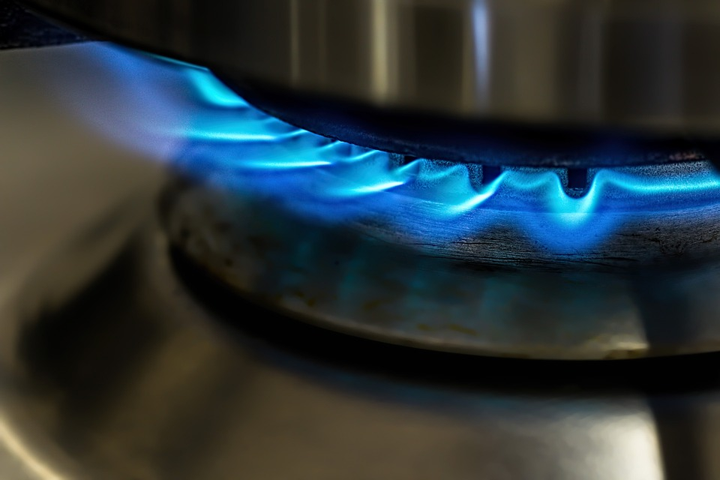
Reinforcement Learning
A different way to approach machine learning, based on human psychology
Based on how humans learn about good decisions from rewards and bad decisions from penalties
Pixabay
Notes:
For example, you might touch a hot stove and it’ll burn (which is a negative reward, or penalty), and you’ll learn not to touch it again
Or you might eat a piece of candy and get a positive reward and you’ll learn to want to eat more
This mirrors how we as humans learn from good and bad rewards as we grow up

Slide 37
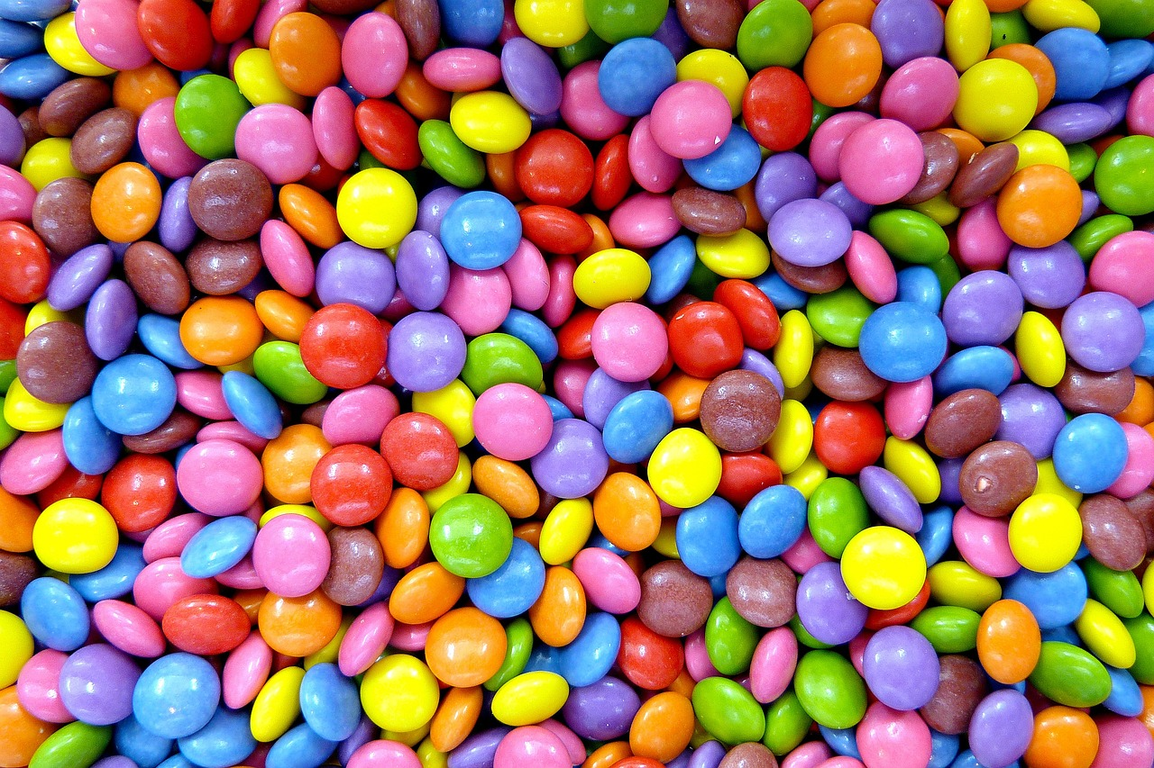
Reinforcement Learning
A different way to approach machine learning, based on human psychology
Based on how humans learn about good decisions from rewards and bad decisions from penalties
Pixabay
Pixabay
Notes:
For example, you might touch a hot stove and it’ll burn (which is a negative reward, or penalty), and you’ll learn not to touch it again
Or you might eat a piece of candy and get a positive reward and you’ll learn to want to eat more
This mirrors how we as humans learn from good and bad rewards as we grow up

Slide 38
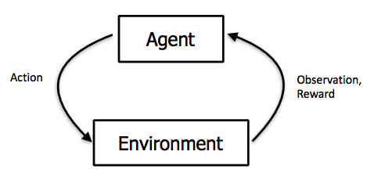
Reinforcement Learning
Frames the question of intelligence as getting the most reward in a particular environment
Learn from trial-and-error by taking different actions and seeing which actions give you the most reward
Notes:
Explain the graphic: in RL, we think about the agent as the ML system interacting with the environment -- for example, the agent might be a robot and the environment is the world it’s in. The robot or agent would take an action, which could change the environment, and the environment would tell the robot if this was a good action or not

Slide 39
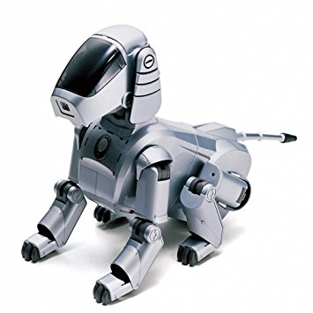

Reinforcement Learning
Particularly useful for tasks where the system needs to learn how to make sequential decisions
Like playing a video game or moving a robot
Notes:
Can pause to ask how people think RL works to best play a video game -- remembering the framing of agent and environment

Slide 40
Discussion
Chat with the people next to you and come up with one example each of:
supervised learning
unsupervised learning
reinforcement learning

Slide 41
Data
Notes:
Good break point (~40 minutes)

Slide 42
Describing data to computers
We can’t communicate with computers the same way we communicate to humans
For example:
We need to do some extra work to describe an image to a computer

Slide 43
Describing data to computers
We can’t communicate with computers the same way we communicate to humans
For example:
We need to do some extra work to describe an image to a computer
We have to pick and choose what about that image we want to tell our computers

Slide 44
Describing data to computers
We can’t communicate with computers the same way we communicate to humans
For example:
We need to do some extra work to describe an image to a computer
We have to pick and choose what about that image we want to tell our computers
The measurable properties that we use to describe our examples are called features

Slide 45
Features
Feature: a measurable property or characteristic of our data
(e.g., height/weight, number of letters, etc)
Notes:
(Can give a concrete example here, like height is a feature of a person, or number of letters is a feature of a word)

Slide 46
Features
Feature: a measurable property or characteristic of our data
Picking what features to use is a really important task in machine learning (feature selection)

Slide 47
Features
Feature: a measurable property or characteristic of our data
Picking what features to use is a really important task in machine learning (feature selection)
Features can be:
Binary (yes / no)
Discrete (small number of specific values)
Real-valued (any real number)
Notes:
binary: is this person a student or not
discrete: how many trees are in a specified area
real-valued: what is the average temperature of a city

Slide 48
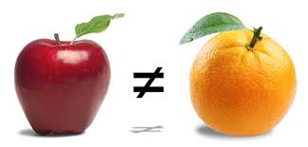
Example: Apple vs Orange
Say we wanted to teach a computer how to tell the difference between apples and oranges
What features of fruits might be useful for it to know?
Notes:
PAUSE HERE TO GET STUDENT RESPONSES! (This also may get them to be silent, which is a great prompt to go back to the definition of features again)
Note that this is a tough question! The concept of ‘features’ are still very abstract at this point

Slide 49
Example: Apple vs Orange
Say we wanted to teach a computer how to tell the difference between apples and oranges
What features of fruits might be useful for it to know?
Size?
Shape?
Color?
Has seeds?
Notes:
And are these features binary, discrete, or real-valued?
Notice that not all features are useful in differentiating apples and oranges -- color is super helpful, but size and has seeds might not! That’s why we want to be sure to pick the best features for the particular task

Slide 50
Examples and Datasets: Some Formalism
An example, x, is a particular instance of data (could be a picture, an email, a sentence, a song) described only by a set of features x_{n}
x = (x₁, x₂, x₃, …) for example, x = (1.5, green, yes)
Notes:
When we think of an example, like a photo or a sentence, we only describe it by its features
Thus, each example is merely a set of features
(In this example, this could be 1.5”, color green, and has seeds)

Slide 51
Examples and Datasets: Some Formalism
An example, x, is a particular instance of data (could be a picture, an email, a sentence, a song) described only by a set of features x_{n}
x = (x₁, x₂, x₃, …) for example, x = (1.5, green, yes)
A labelled example is one that includes a label y
(x, y) for example, ((1.5, green, yes), apple)

Slide 52
Examples and Datasets: Some Formalism
An example, x, is a particular instance of data (could be a picture, an email, a sentence, a song) described only by a set of features x_{n}
x = (x₁, x₂, x₃, …) for example, x = (1.5, green, yes)
A labelled example is one that includes a label y
(x, y) for example, ((1.5, green, yes), apple)
A dataset is a collection of labelled and/or unlabelled examples
D = {(x₁, y₁), (x₂, y₂), …}
D = {((1.5, green, yes), apple), ((1.5, orange, yes), orange)}
Notes:
This particular example of a dataset would thus have 2 labelled examples: an apple and an orange

Slide 53
Training and Generalization

Slide 54
Training
Training: the process of using data to teach a model so that it can learn to predict the correct label
Different ML algorithms approach training differently
Recall what a model is:
Notes:
(We’ll talk about a few different supervised learning algorithms in the next two lessons, and you may encounter them in your projects as well)

Slide 55
Training Set and Training Error
To train our model, we use data that we know is correctly labelled -- we call this our training set
We measure our model’s performance during training by looking at training error, or how accurate its predictions are for the examples we have seen in the training set
Notes:
Can mention here a typical training process: we give the model a new example and have it make a prediction; we then compare the prediction to the actual label and adjust the model based on whether it was correct or not. The main goal of the training process is to make these adjustments so that the model can more accurately predict labels for future examples
We’ll discuss more about “training error” or how to evaluate the accuracy of a model shortly

Slide 56
Generalization
Doing well on just the training data is not enough
With training data, we are given the correct labels for each example and can train our model to label those specific examples well
But how do we know our model will generalize well on future, unseen examples?
Notes:
Say we complete the training process and have low training error -- this means our model has learned to accurately predict the labels for the examples in our training set … but how do we know it will work well for examples outside of our training set?

Slide 57
Fitting to your data
Just because our model does well on training data does not mean it will do well on unseen data

Slide 58
Fitting to your data
Just because our model does well on training data does not mean it will do well on unseen data
Memorization: Ability to do well only on data we have seen
Generalization: Ability to do well on data we have not seen

Slide 59
Fitting to your data
Just because our model does well on training data does not mean it will do well on unseen data
Memorization: Ability to do well only on data we have seen
Generalization: Ability to do well on data we have not seen
Instead of memorizing the correct labels for the specific examples in our training set, find patterns in the data that allow us to generalize
Notes:
It’s like preparing for a math test:
Memorizing would be memorizing the answers to the specific questions asked on a practice test
Generalizing would be understanding the rules used in the practice test and applying them to the actual test

Slide 60
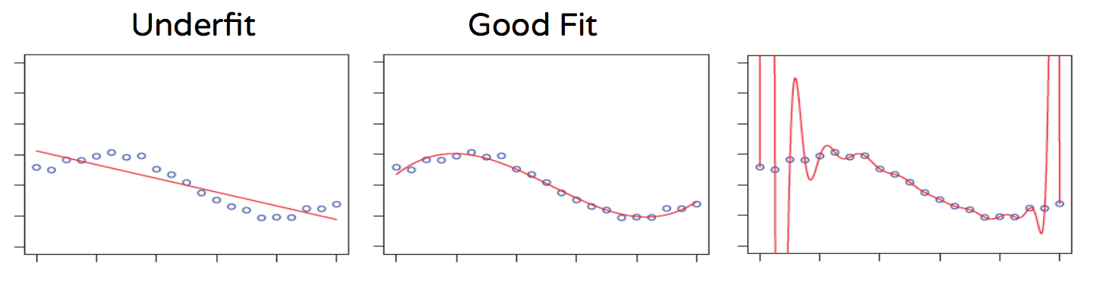
Fitting to your data
Overfitting: When we fit too specifically to the data we’ve seen (memorization)
Underfitting: When the model doesn’t even learn to do well on the data we have seen
Good Fit: If the model understands the patterns in our data and can generalize
Overfit

Slide 61
Using a test set
One way to avoid overfitting is to use a test set
This is a dataset with correct labels that we do not show to our model until after it has finished training
We apply the trained model to the test set to see if it can predict the correct labels on these previously unseen examples
This can tell us if we’ve overfit to our training set, and if so, that we should go back and change things in our training process
Notes:
Specific things we might change: What features we look at, how many features we look at, what sorts of algorithms we use to train our model, etc. We’ll see this more concretely in future lessons.

Slide 62
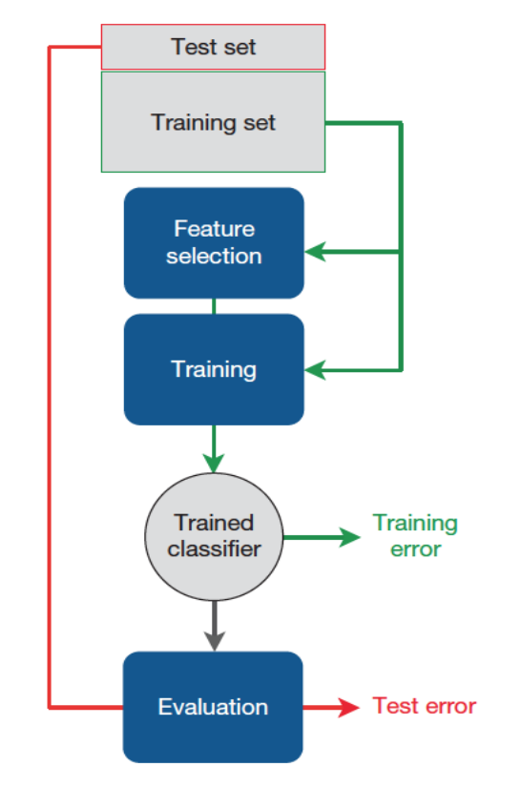
Notes:
A visual representation of breaking it up by training set and test set

Slide 63
Evaluation
Notes:
We just talked about training error and testing error, but how do we actually evaluate the performance of our models?

Slide 64
How can we tell how good our system is?
One way is to look at the accuracy of a model

Slide 65

How can we tell how good our system is?
One way is to look at the accuracy of a model
For supervised learning:
Say we have 100 images of street lights that we want to label as being green, yellow, or red
If our model correctly classifies 95 of these 100 images, then we say our model has a 95% accuracy

Slide 66
Other Metrics for Evaluation
However, accuracy doesn’t tell us the whole picture
There are different types of mistakes that we can make

Slide 67

Other Metrics for Evaluation
However, accuracy doesn’t tell us the whole picture
There are different types of mistakes that we can make
Take the example of detecting whether there the fire sprinkler system is working

Slide 68
Other Metrics for Evaluation
However, accuracy doesn’t tell us the whole picture
There are different types of mistakes that we can make
Take the example of detecting whether there the fire sprinkler system is working
False Positive (FP): When you think the sprinkler system is working, but it isn’t

Slide 69
Other Metrics for Evaluation
However, accuracy doesn’t tell us the whole picture
There are different types of mistakes that we can make
Take the example of detecting whether there the fire sprinkler system is working
False Positive (FP): When you think the sprinkler system is working, but it isn’t
False Negative (FN): When you think the sprinkler system is not working, but it is

Slide 70
Other Metrics for Evaluation
However, accuracy doesn’t tell us the whole picture
There are different types of mistakes that we can make
Take the example of detecting whether there the fire sprinkler system is working
False Positive (FP): When you think the sprinkler system is working, but it isn’t
False Negative (FN): When you think the sprinkler system is not working, but it is
Are these errors equally bad?
Notes:
Let the audience respond to this question! (And then talk a little bit about it after)

Slide 71
Other Metrics for Evaluation
 | Actual: Yes | Actual: No
Predicted: Yes | True Positive (TP) | False Positive (FP)
Predicted: No | False Negative (FN) | True Negative (TN)
Accuracy = (TP + TN) / (TP + TN + FP + FN)
Notes:
Take some time to talk through how to read this table (it can be confusing the first time around looking at it) -- go through what each cell represents.

Slide 72
Other Metrics for Evaluation
 | Actual: Yes | Actual: No
Predicted: Yes | True Positive (TP) | False Positive (FP)
Predicted: No | False Negative (FN) | True Negative (TN)
This table, when filled in with actual numbers, is called a confusion matrix

Slide 73
Other Metrics for Evaluation
Precision: Probability that a positive prediction is correct, TP / (TP + FP)
Recall (or Sensitivity): Probability that an actual positive outcome is predicted correctly, TP / (TP + FN)
Specificity: Probability that an actual negative outcome is predicted correctly, TN / (TN + FP)
F1 Score: Combination of precision and recall,
(2 * Precision * Recall) / (Precision + Recall)
Notes:
Mention that there are many other metrics used for evaluation
They do not need to remember all of them right now, but just see them & know how we calculate them
They can refer back to this slide in the future, but just know these are common metrics we use

Slide 74
Finding Data

Slide 75
Where do we get the data?
Notes:
There are a few different ways we can collect data for our dataset

Slide 76
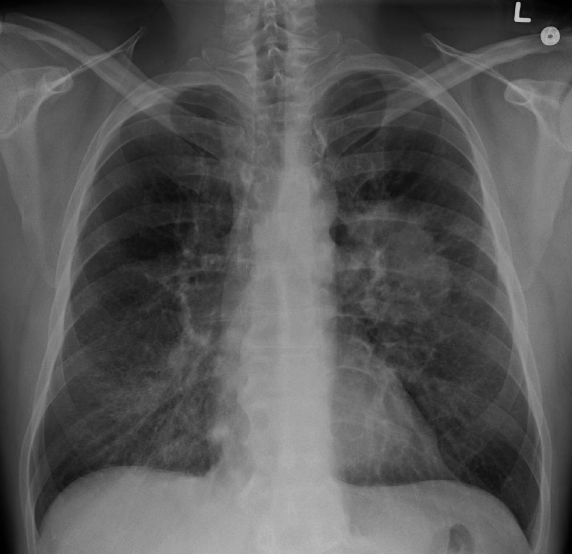
Where do we get the data?
For examples that require more expertise to label, like medical images for lung cancer, we need doctors to collect and then manually label these images

Slide 77
Where do we get the data?
For examples that require more expertise to label, like medical images for lung cancer, we need doctors to collect and then manually label these images
For examples that require less expertise to label, we can collect them from the internet, create them ourselves, or use publicly available datasets
Notes:
This process can indeed be time-consuming, especially for the cases when data needs to be manually labelled -- this is why data can be hard to get

Slide 78
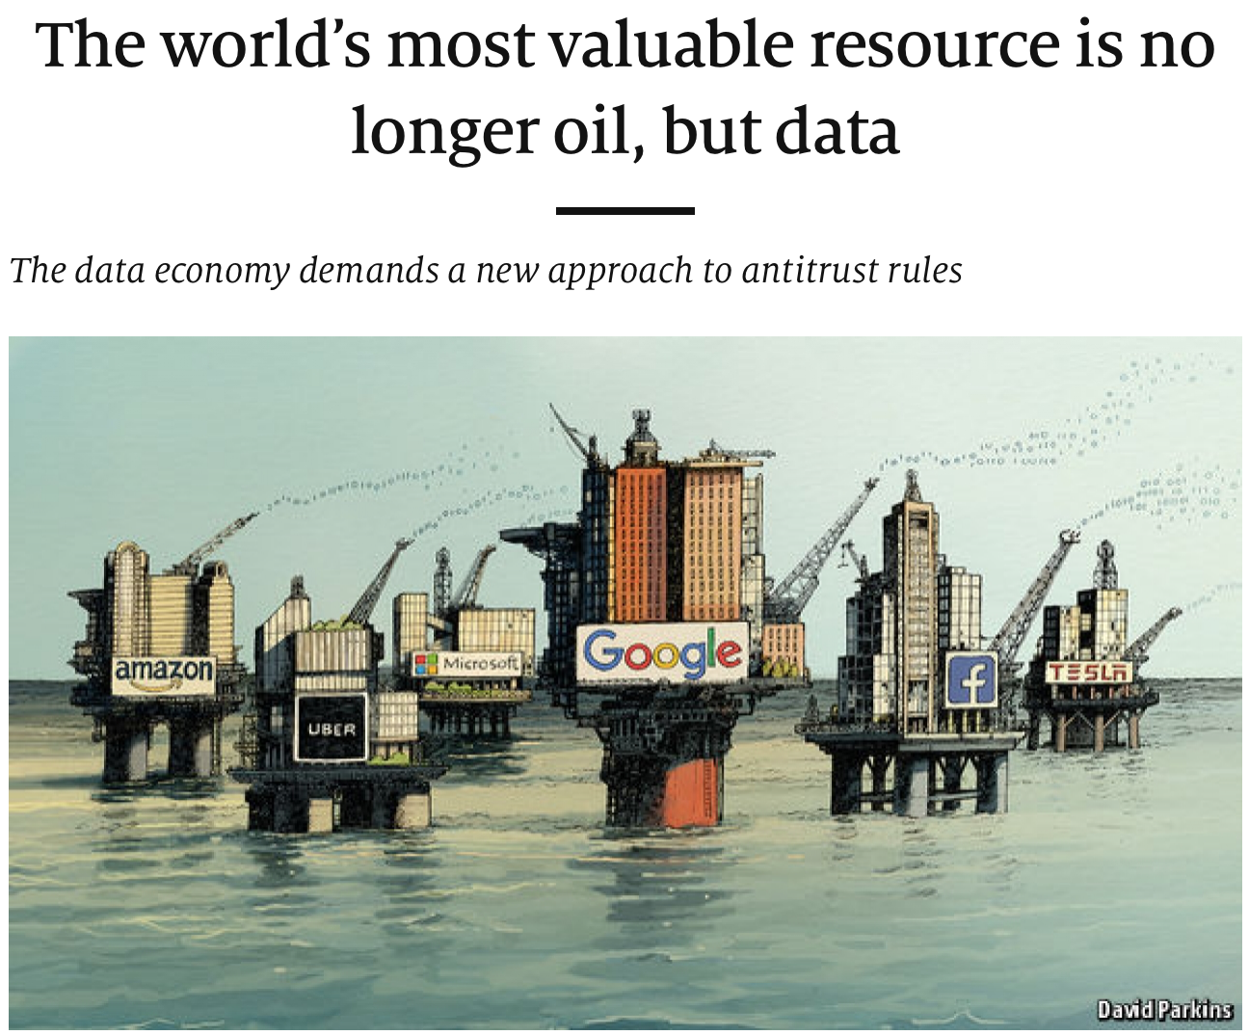
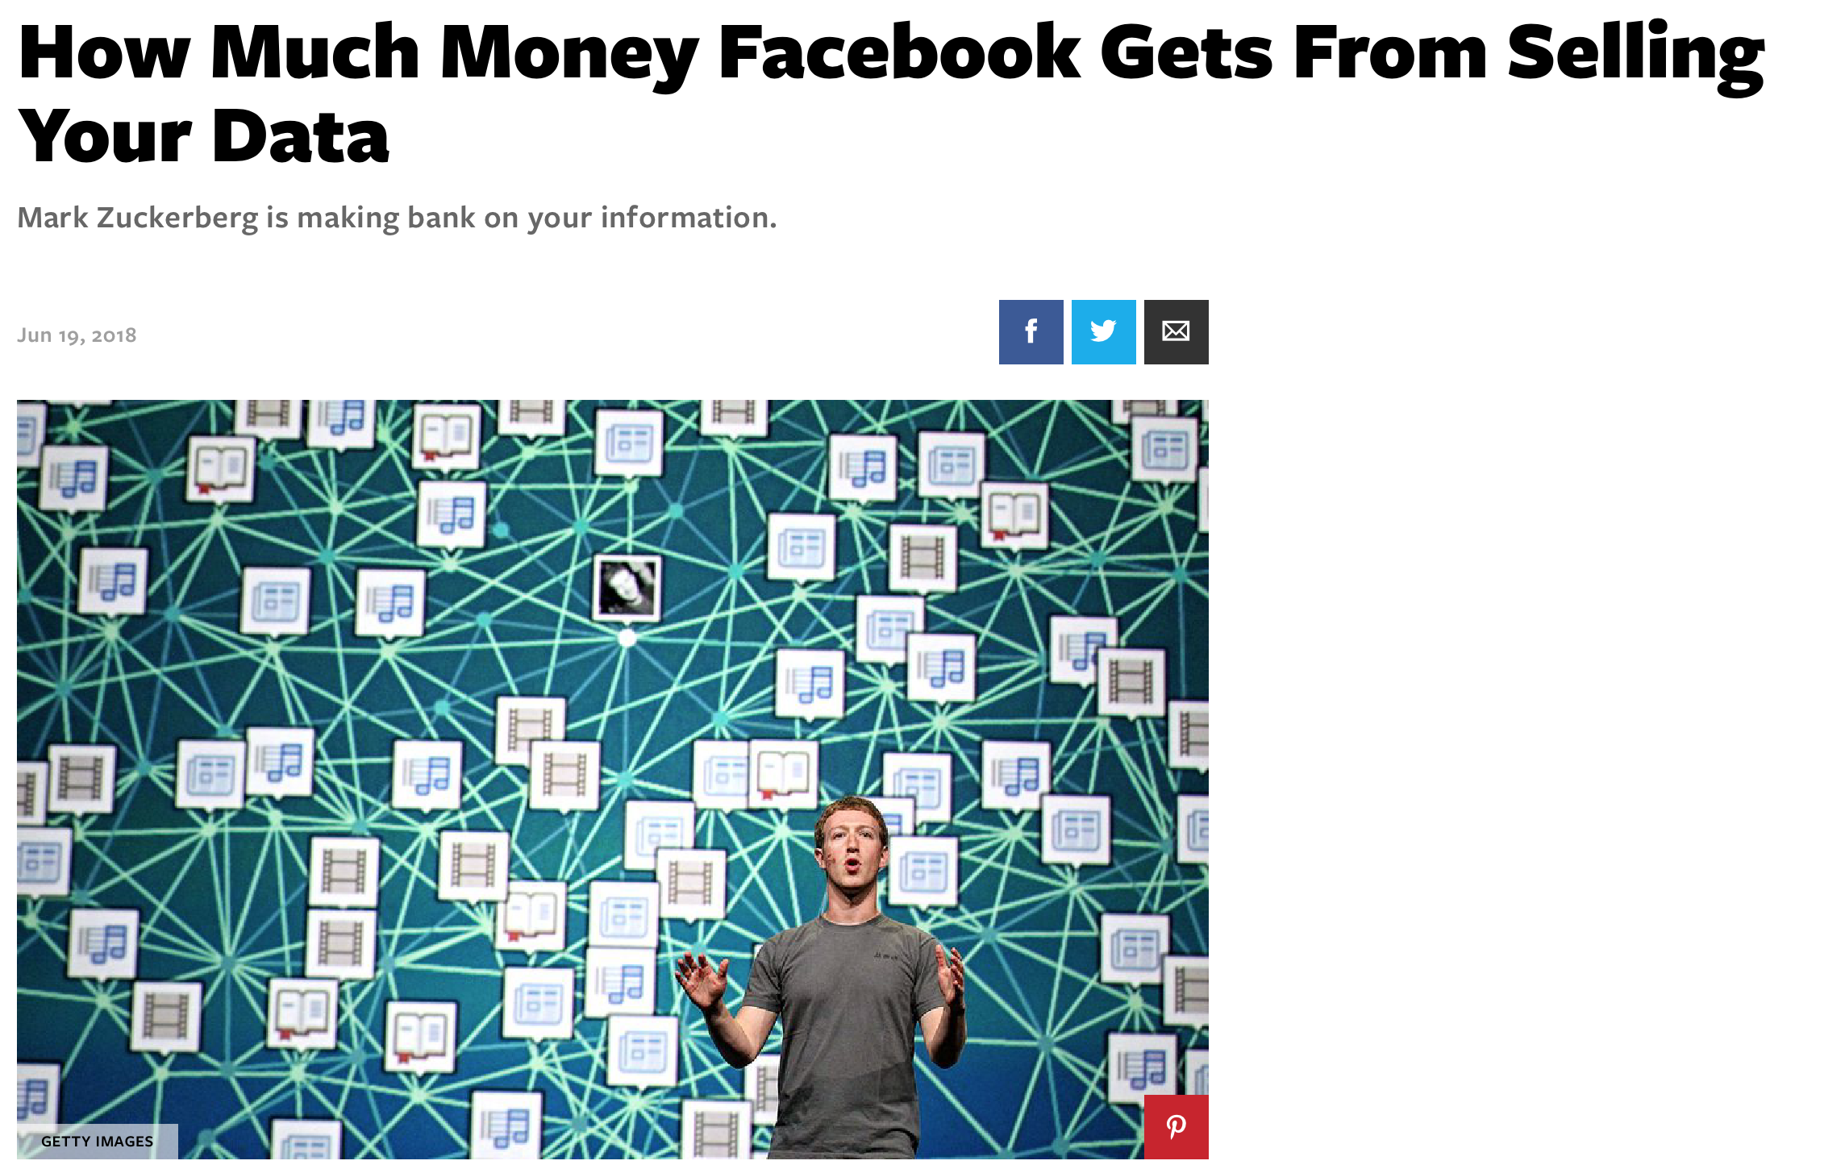
The Importance of Datasets
Notes:
Datasets are really, really important for machine learning to do well
This is why companies often create good datasets: to sell and profit from them
A good dataset can help your machine learning algorithm, but a bad dataset can hurt

Slide 79
The Importance of Datasets
A model cannot learn to do well if the dataset is bad
If your task is to classify pictures as containing cats, dogs, or neither, what happens if your training dataset does not have any pictures of dogs?
Datasets can lack representation and reflect human biases that machine learning models will amplify
Notes:
Be sure to stop and ask them the first question -- see what the students respond with
(The answer: If it’s never seen dogs, how will it know what a dog looks like?)
Also, if it’s only seen one color of dog, one can imagine it would be hard for the system to identify dogs of a different color
So we want to collect as much data as we can and make sure that data is representative and diverse…

Slide 80
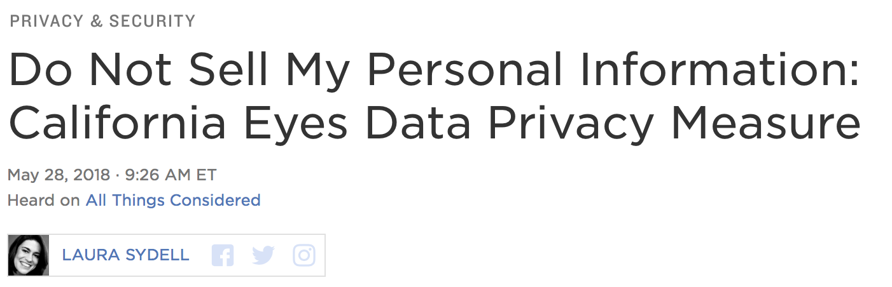
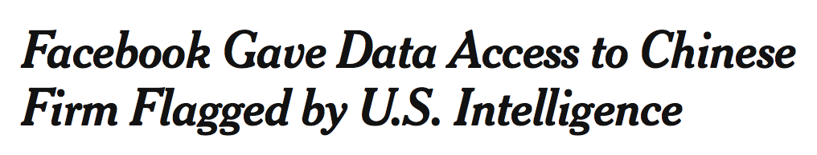
Data Protection and Privacy
The collection and selling of data has brought up legal questions of privacy and anonymity
Notes:
but when we’re collecting personal data, we have to think about privacy concerns.

Slide 81
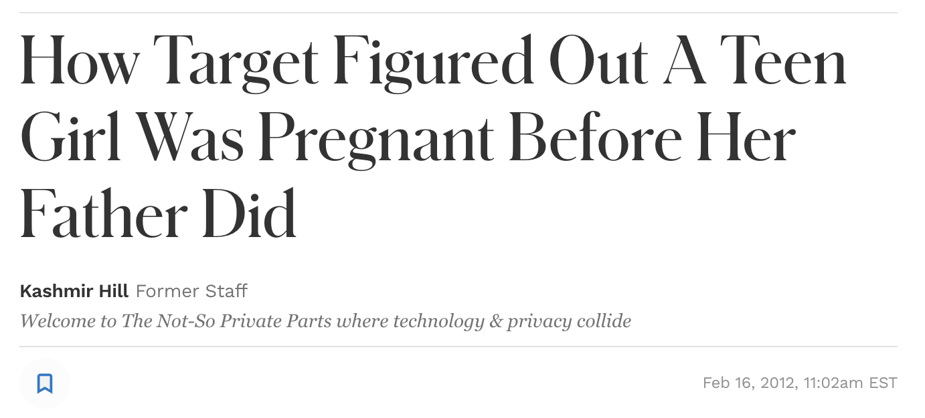
Data Protection and Privacy
The collection and selling of data has brought up legal questions of privacy and anonymity
Data can often contain personal or sensitive information
Notes:
(tyler: added the target study as it really stands out in my mind, but feel free to remove if it’s not thematic)
https://www.forbes.com/sites/kashmirhill/2012/02/16/how-target-figured-out-a-teen-girl-was-pregnant-before-her-father-did/

Slide 82
Data Protection and Privacy
The collection and selling of data has brought up legal questions of privacy and anonymity
Data can often contain personal or sensitive information
We should follow good practices to protect privacy: this is called data stewardship
Notes:
Laws like the EU’s GDPR have been passed to help protect consumer data (look at articles on the right)

Slide 83
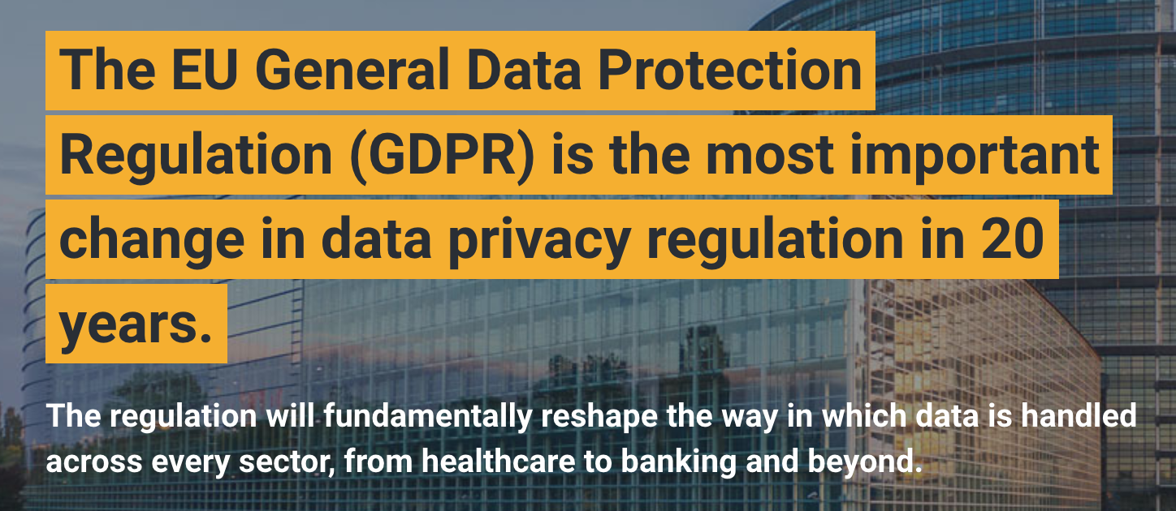
Data Protection and Privacy
The collection and selling of data has brought up legal questions of privacy and anonymity
Data can often contain personal or sensitive information
We should follow good practices to protect privacy -- this is called data stewardship
Notes:
In order to have good data stewardship:
Laws like the EU’s GDPR have been passed to help protect consumer data (look at articles on the right)
Some states in the US have also passed laws to protect citizens’ data

Slide 84
Exercises

Slide 85
Concepts Learned
Machine Learning
Supervised Learning
Unsupervised Learning
Reinforcement Learning
Models
Features
Examples and datasets
Training Set vs Test Set
Overfitting vs Underfitting
Accuracy
Confusion Matrix (TP/FP/TN/FN)
Precision / Recall
Data Stewardship
Notes:
Go through each -- perhaps get a different student to give an answer for each

Slide 86
Let's Code!

